Slide 1

School of Engineering and Technology
AI-Powered ECG Analysis for Early
Heart Disease Detection : A Research Study
Project ID: Y1-2024-25-G304
Team Members:
Anantika Paul (2401560042)
Jimni Gogoi (2401560041)
Supervisor: Dr Yogita Raghav

Slide 2
Cardiovascular diseases (CVDs) are the leading cause of death worldwide.
Early detection is critical for effective treatment and management.
Electrocardiograms (ECGs) are the primary tool for diagnosing heart abnormalities.
Manual ECG interpretation is time-consuming, error-prone, and requires expertise.
There's a strong need for automated, accurate, and interpretable ECG classification systems.
Introduction to the Problem

Slide 3
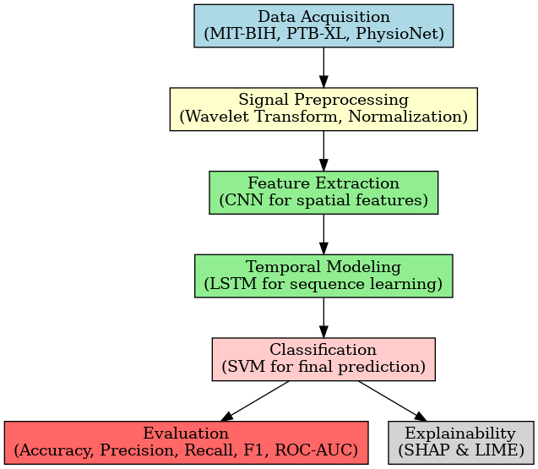
Proposed Solution Overview
Investigate a hybrid CNN-LSTM-SVM model for ECG classification.
Integrate SVM for robust classification from learned deep features.
Incorporate explainable AI (SHAP & LIME) for transparency and interpretability.
Validate the proposed method using benchmark ECG datasets (e.g., MIT-BIH)
Contribute to the field of interpretable AI in healthcare diagnostics.

Slide 4
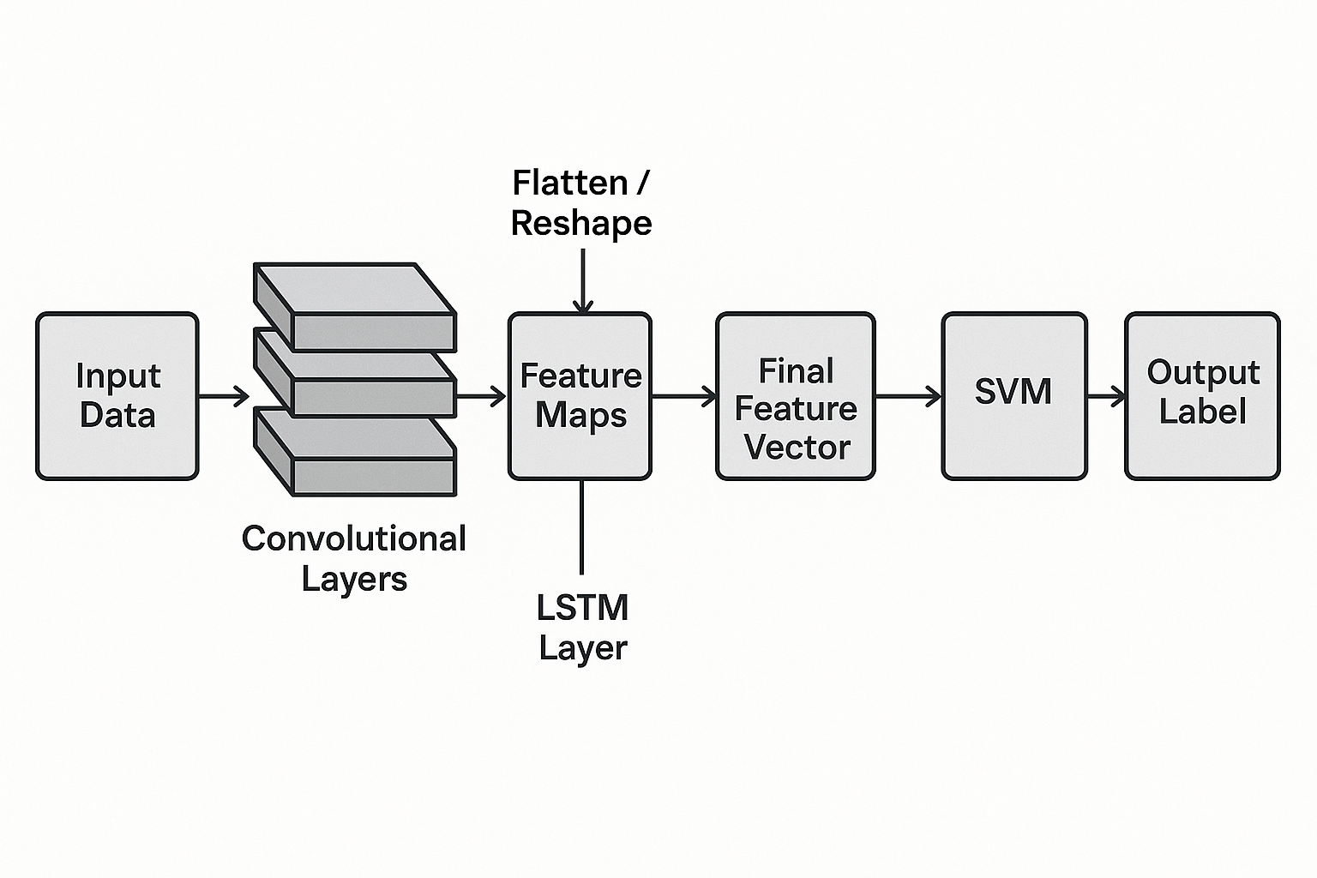
The solution
Structure of Proposed Hybrid CNN-LSTM + SVM model

Slide 5
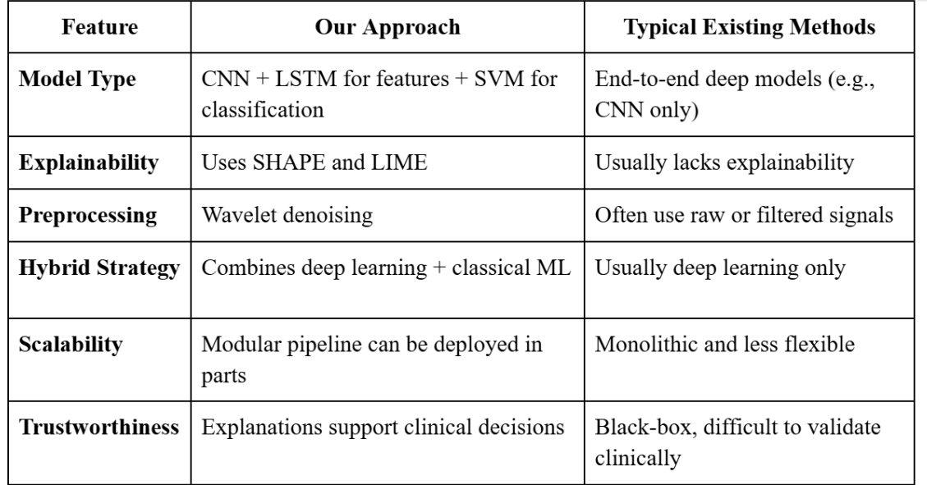
Key Innovations Over Existing Methods

Slide 6
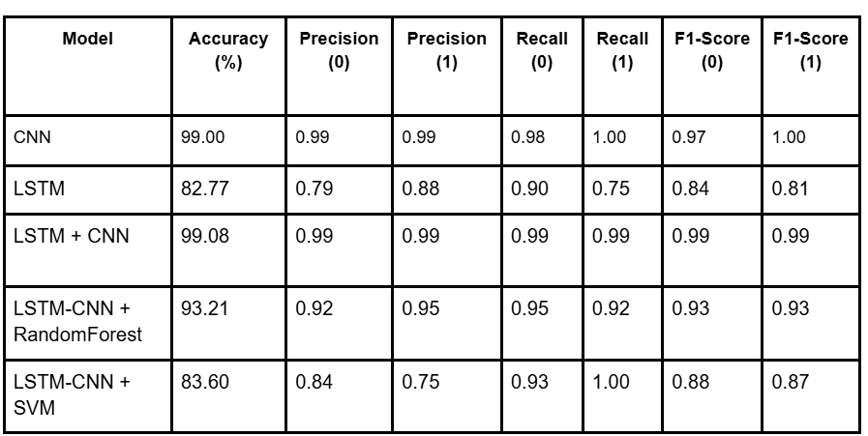
Comparison Table of The Models

Slide 7
THANK YOU

